Slide 1

Tech dividend design

Slide 2



timeline
08/12 14/12 15/12
-Descriptives -Color variation & Brightness -Comments Model -Caption Topic Popularity -Likes Model -Trends during/after festival -Tickets sold -Variety
Aggregation levels
Primary Models
Conclusions
Presentation
-Likes -Comments -Thematic
-Combinors (RF, Ensemble)
-Trends (descriptive)
- Linguistic Reach
-Succes & Engagement Factors
-Shortcomings
-Future research
-Managerial -Technical -Q&A
Secondary Models
-Football interaction -Variety -Color variation -Wait list tickets

Slide 3
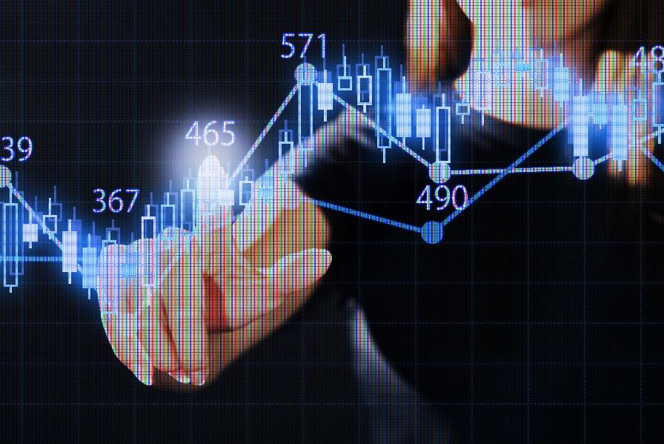
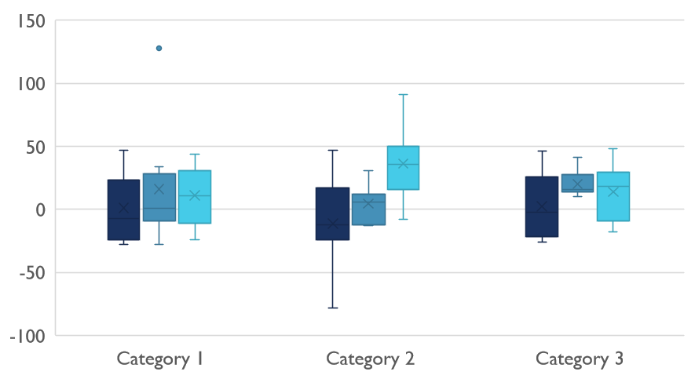
Competitive Landscape

Slide 4
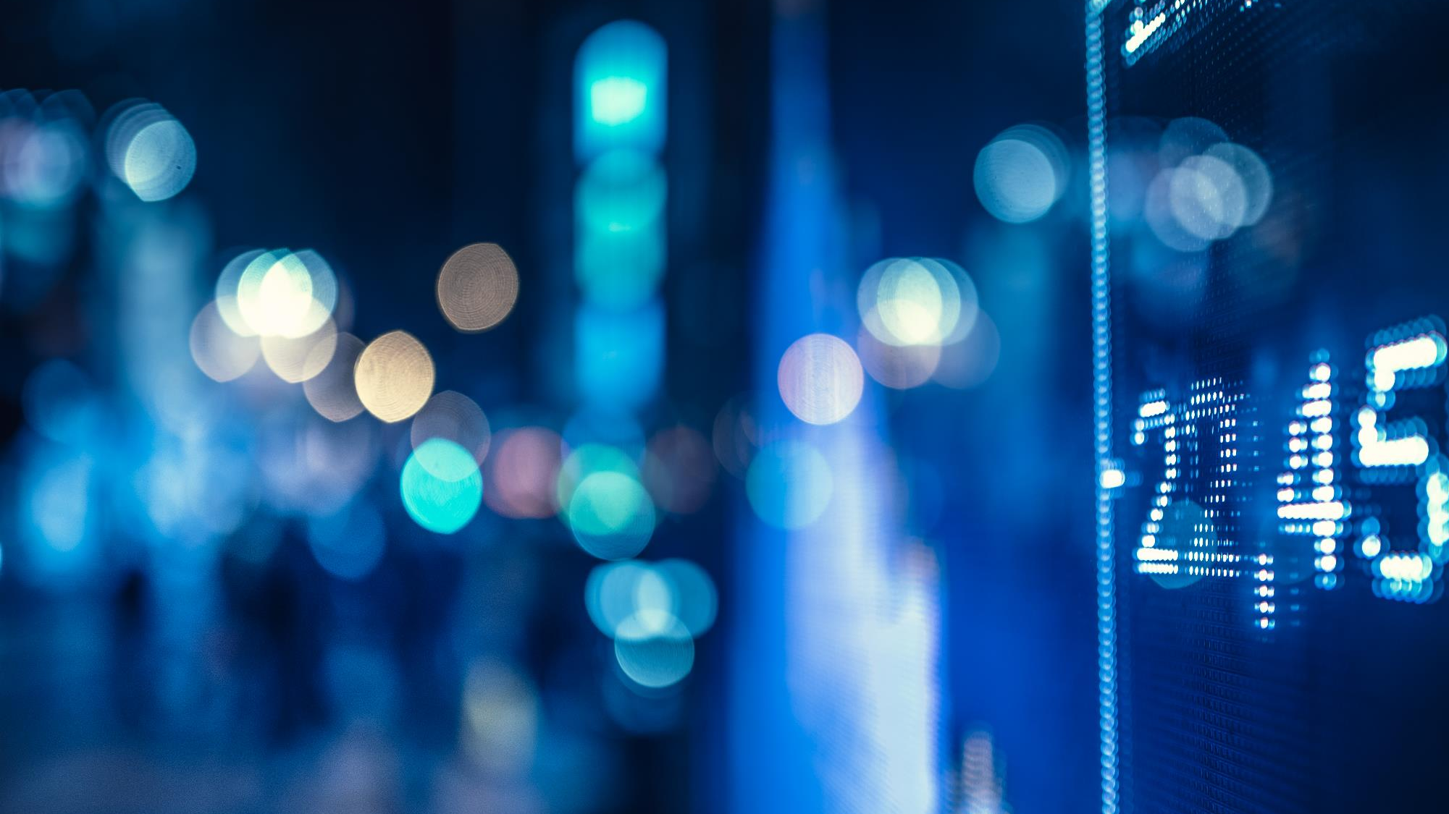
Digital Communications
Cloud
Local
Hybrid

Slide 5

Thank You
someone@example.com

